Slide 1
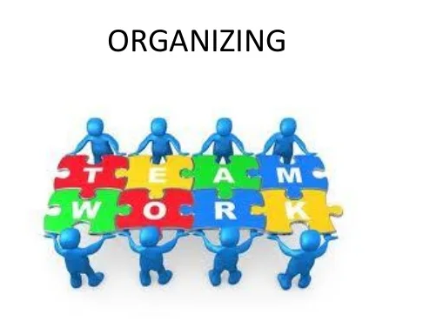
Module –II

Slide 2
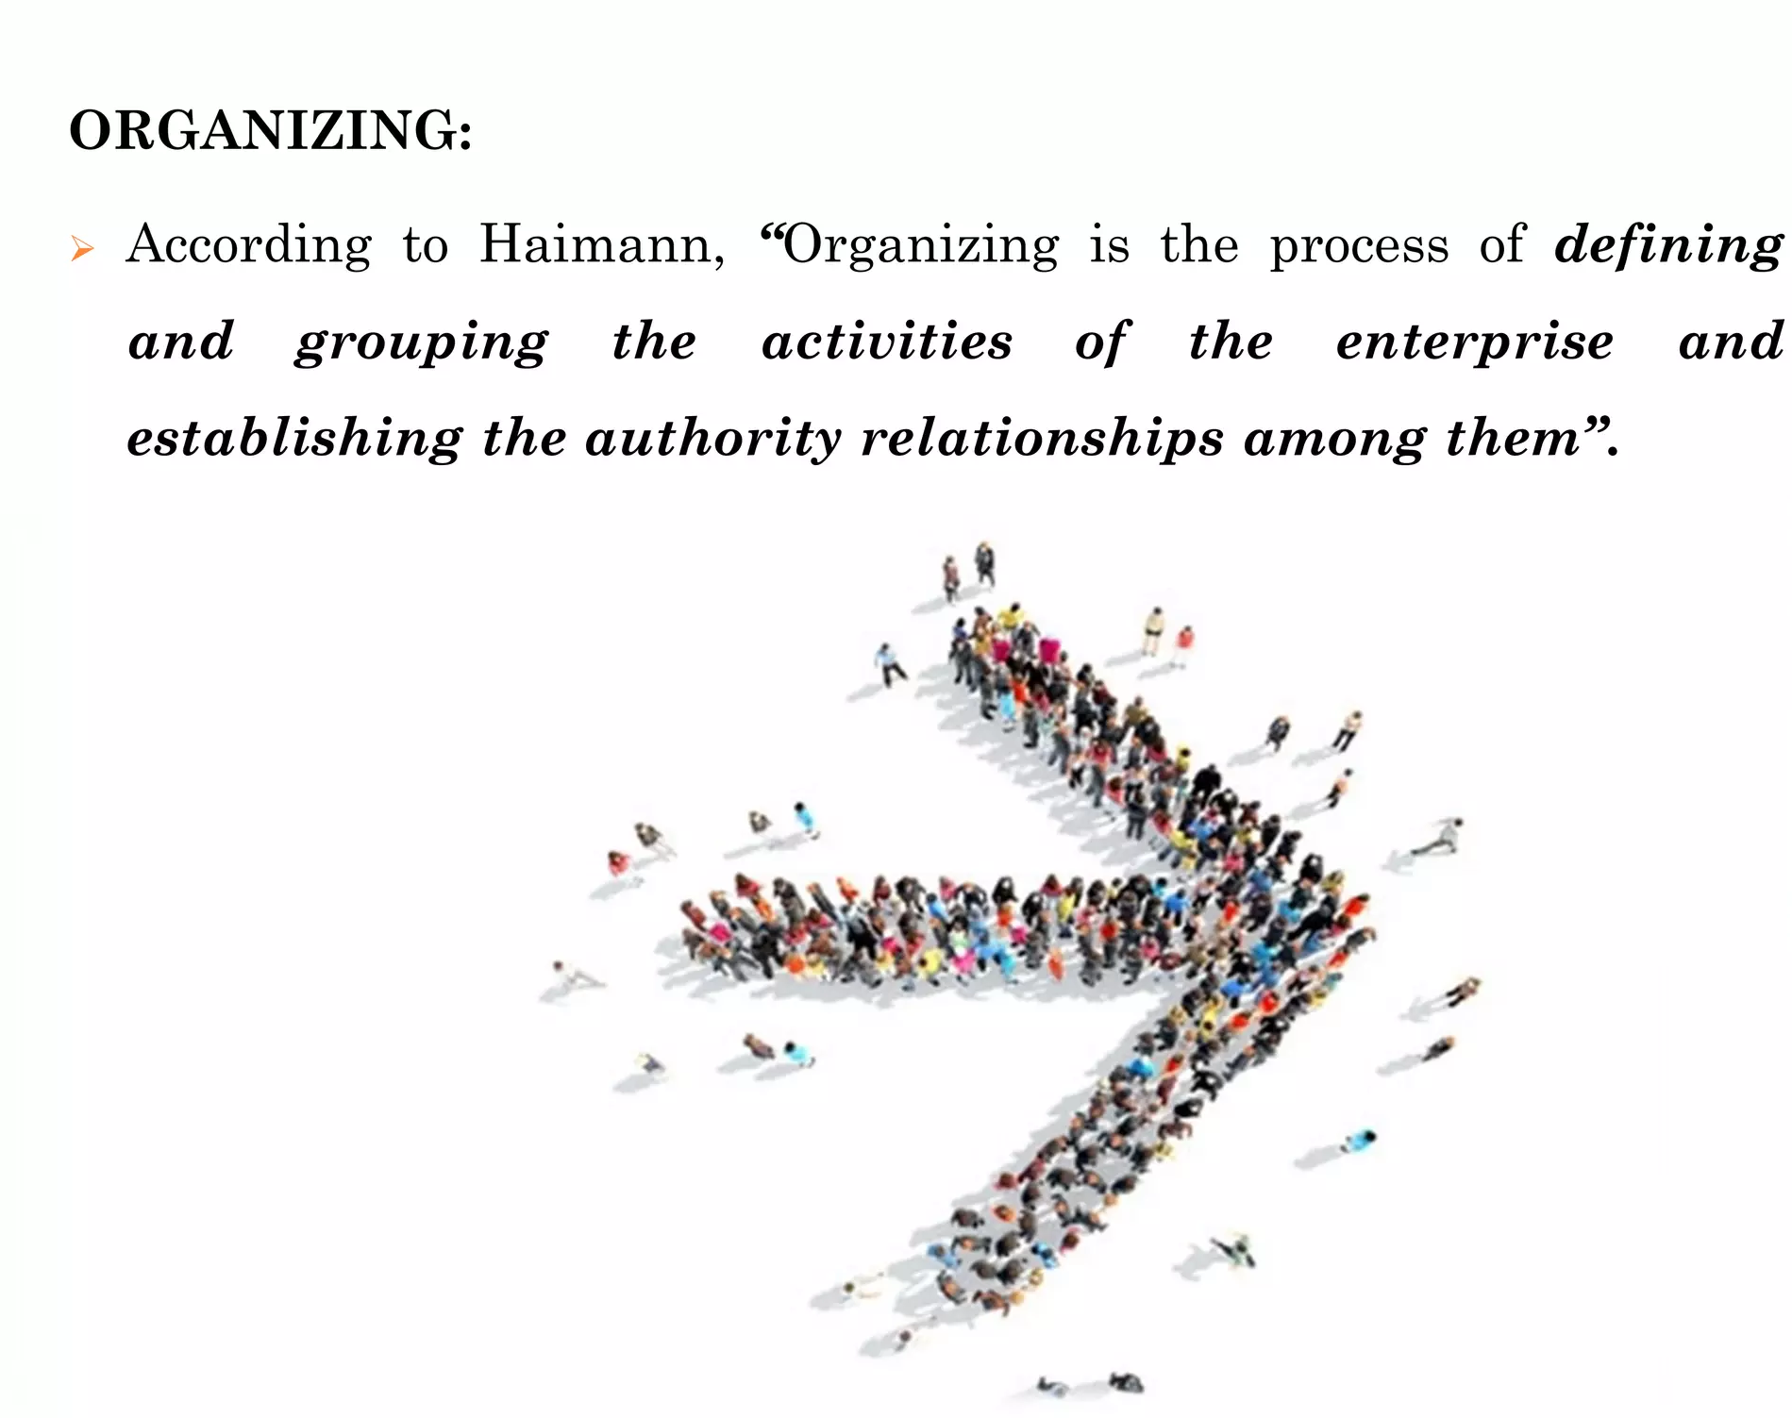

Slide 3
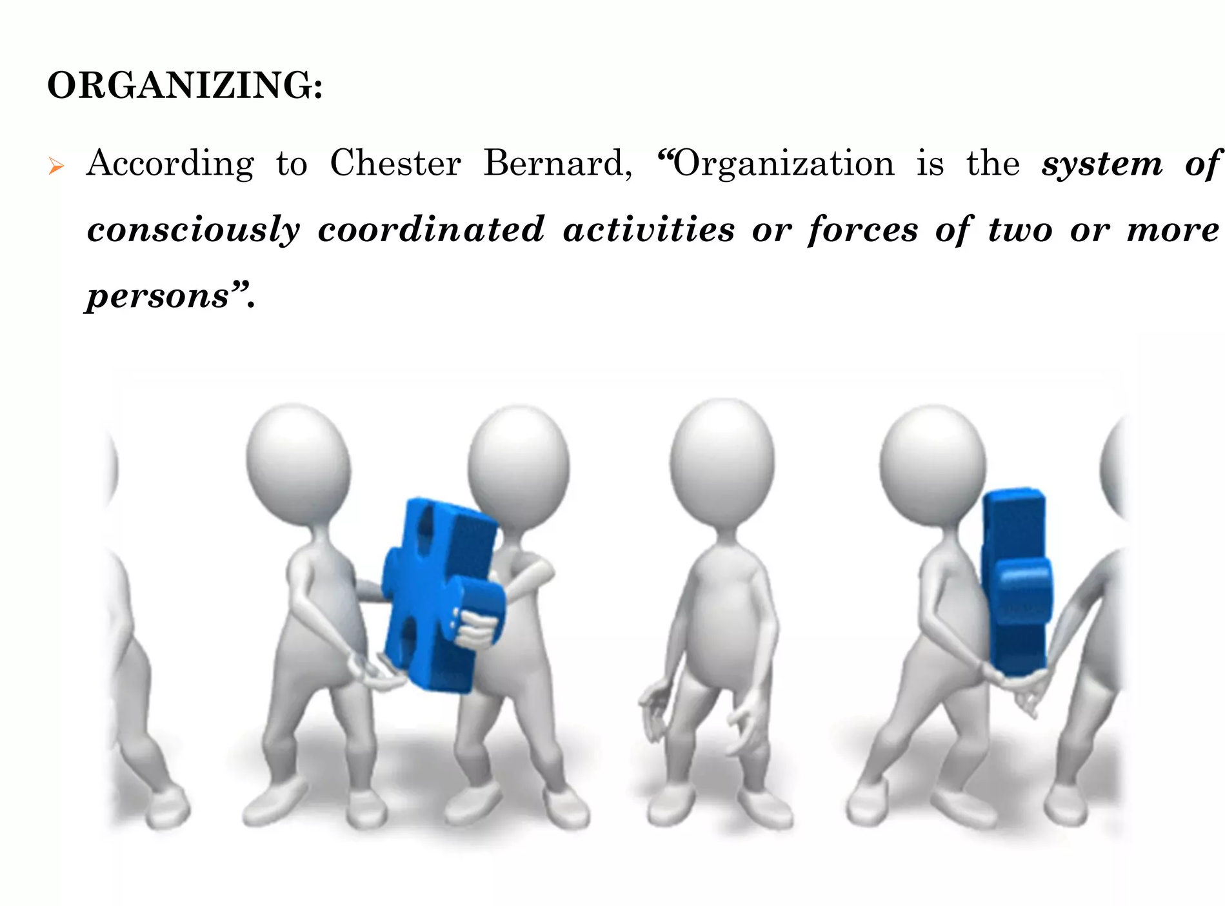

Slide 4
ORGANIZING
As a function of management
The process involving the identification and grouping of activities to be performed
Organising consists of determining and arranging for men, materials, machines and money required by an enterprise for the attainment of its goals.
Operational sense, the term organising means defining the duties and responsibilities of the people employed. and determining the manner in which their activities are to be interrelated

Slide 5
Organising involves
1) determination of objectives
(2) identification and grouping of activities
(3) allotment of duties
(4) developing relationships

Slide 6
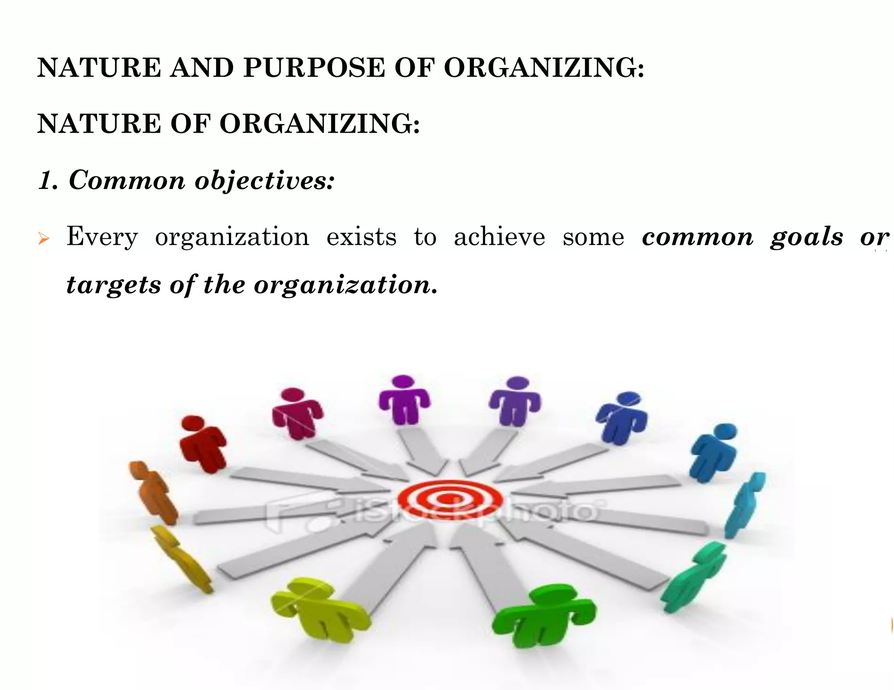

Slide 7
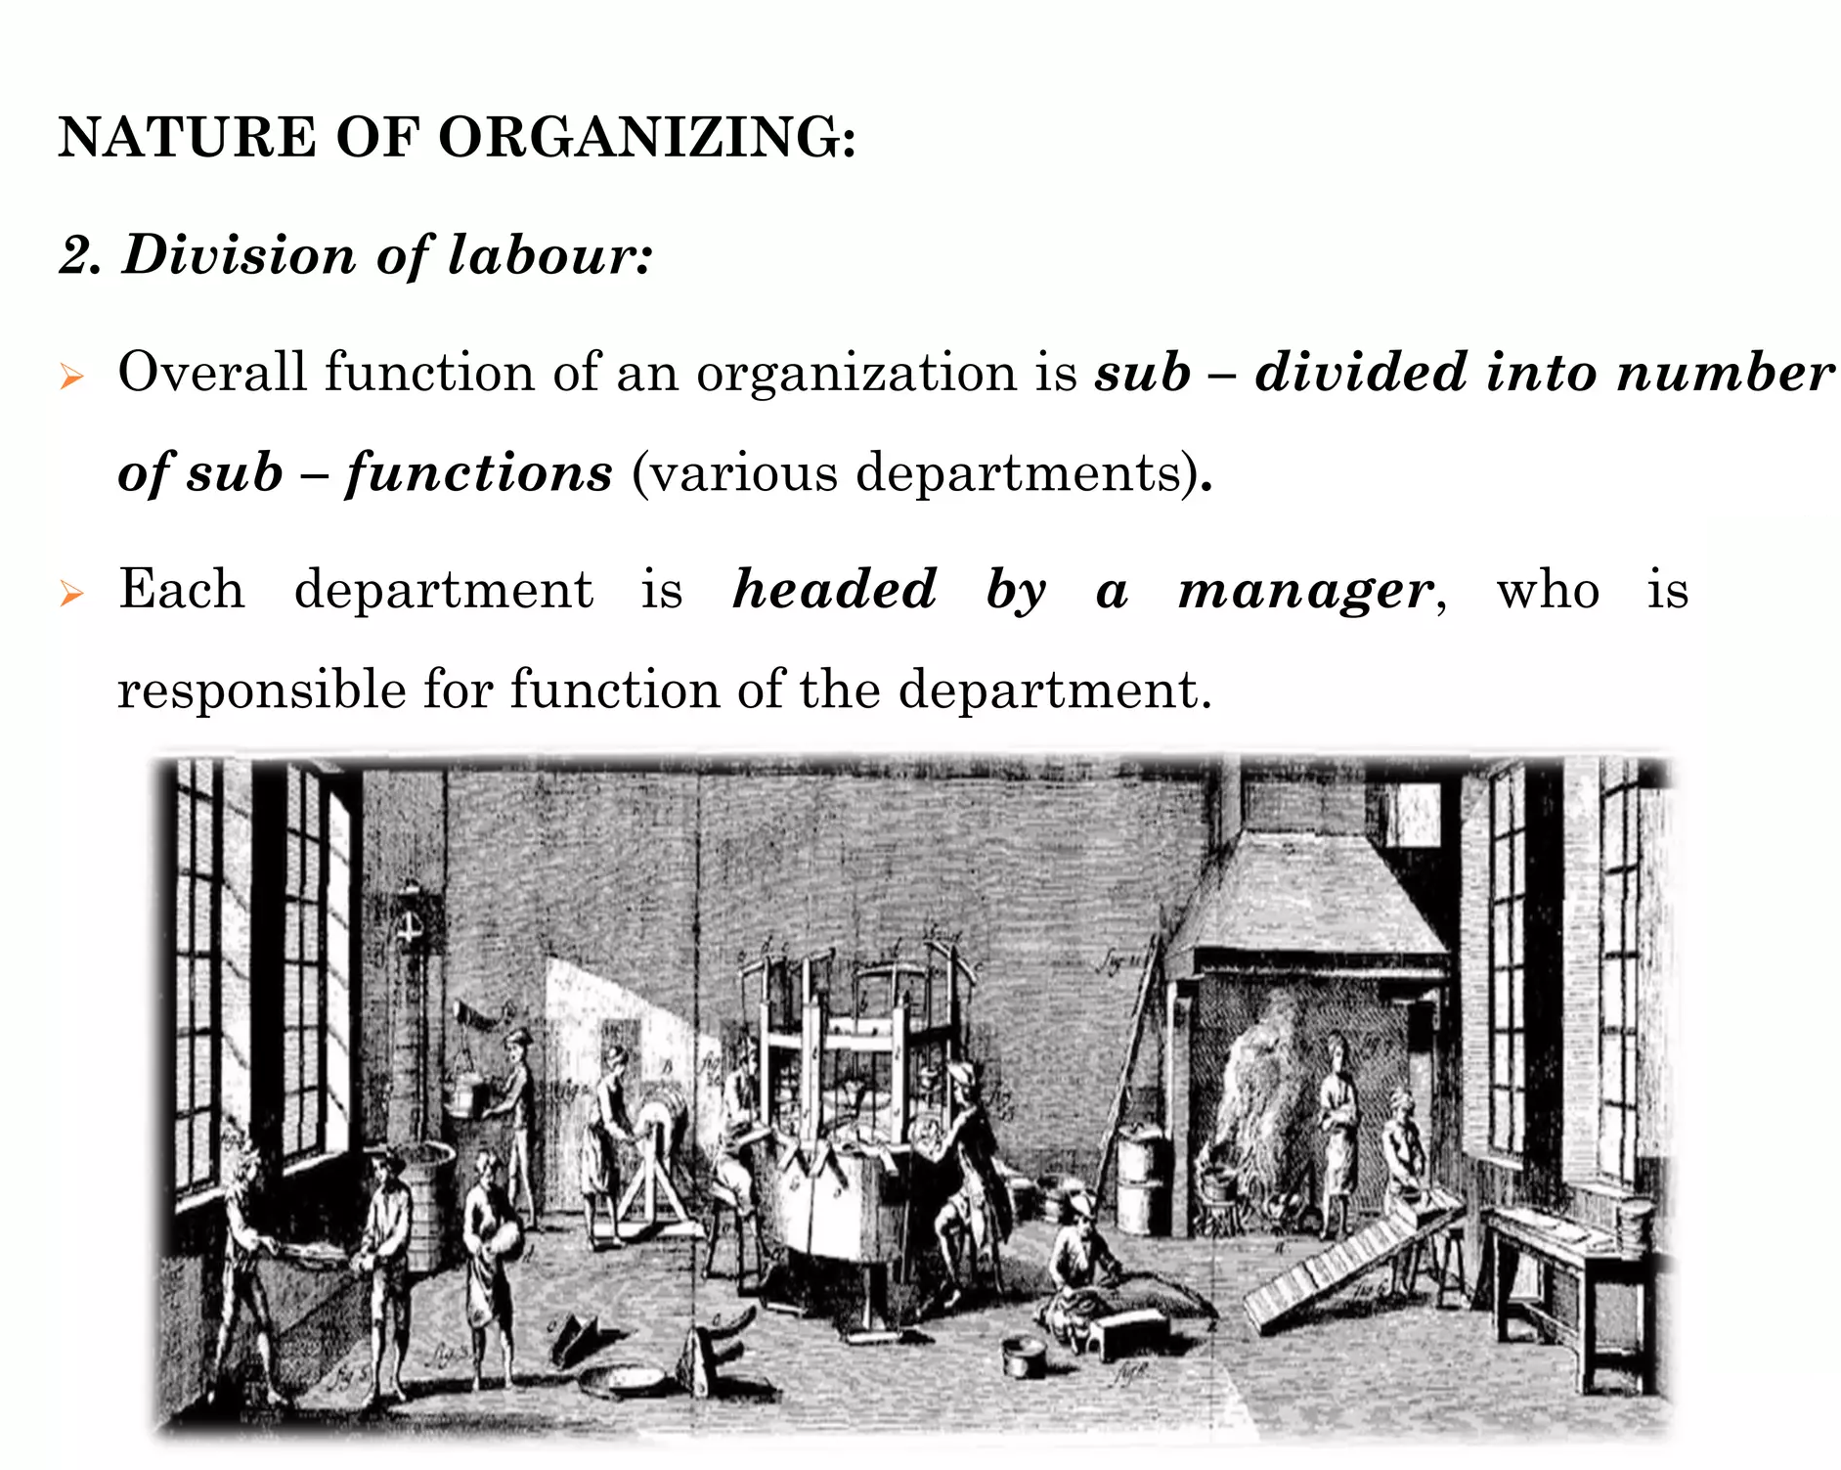

Slide 8
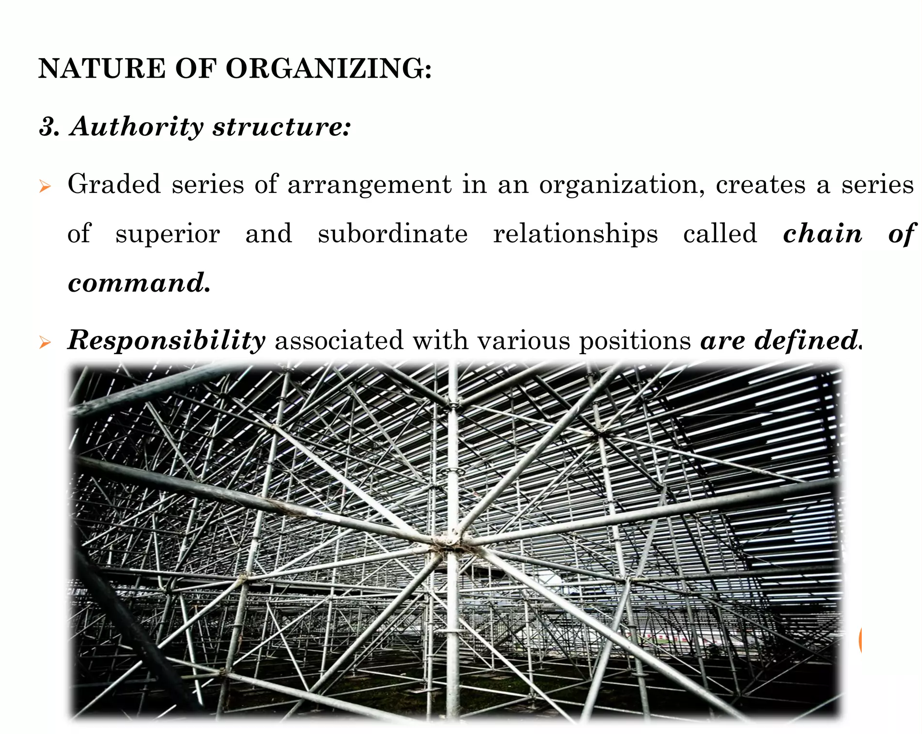

Slide 9
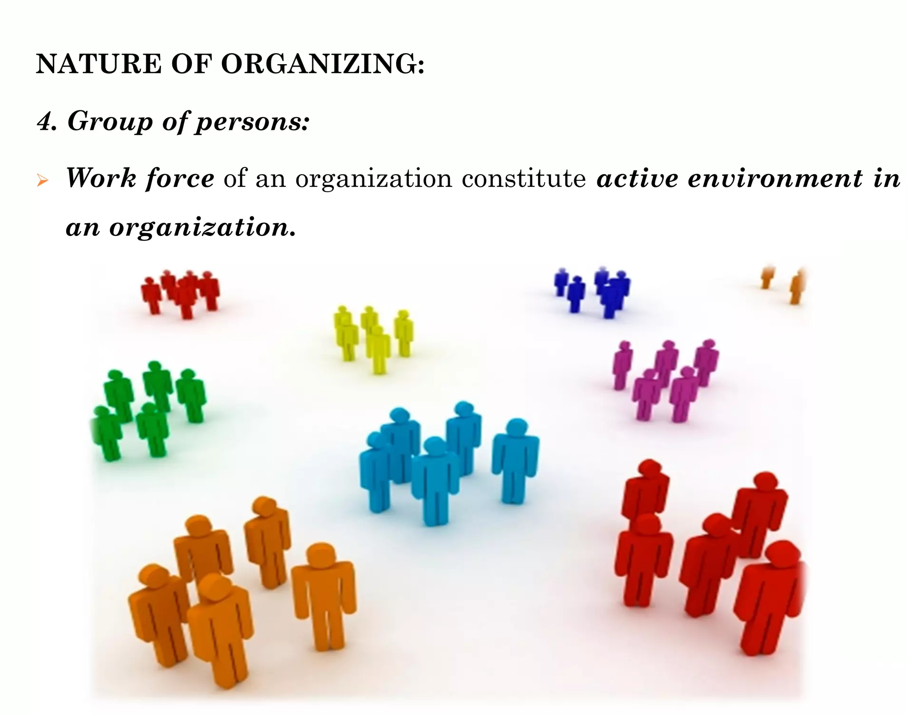

Slide 10
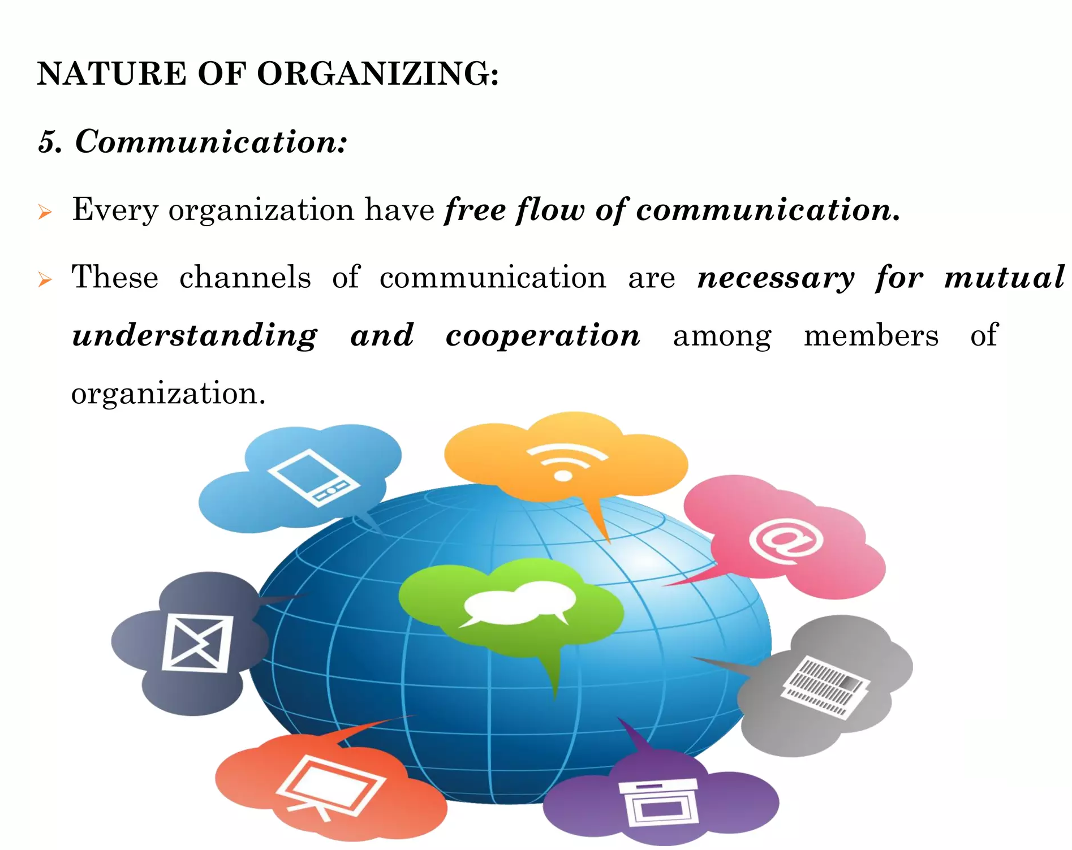

Slide 11
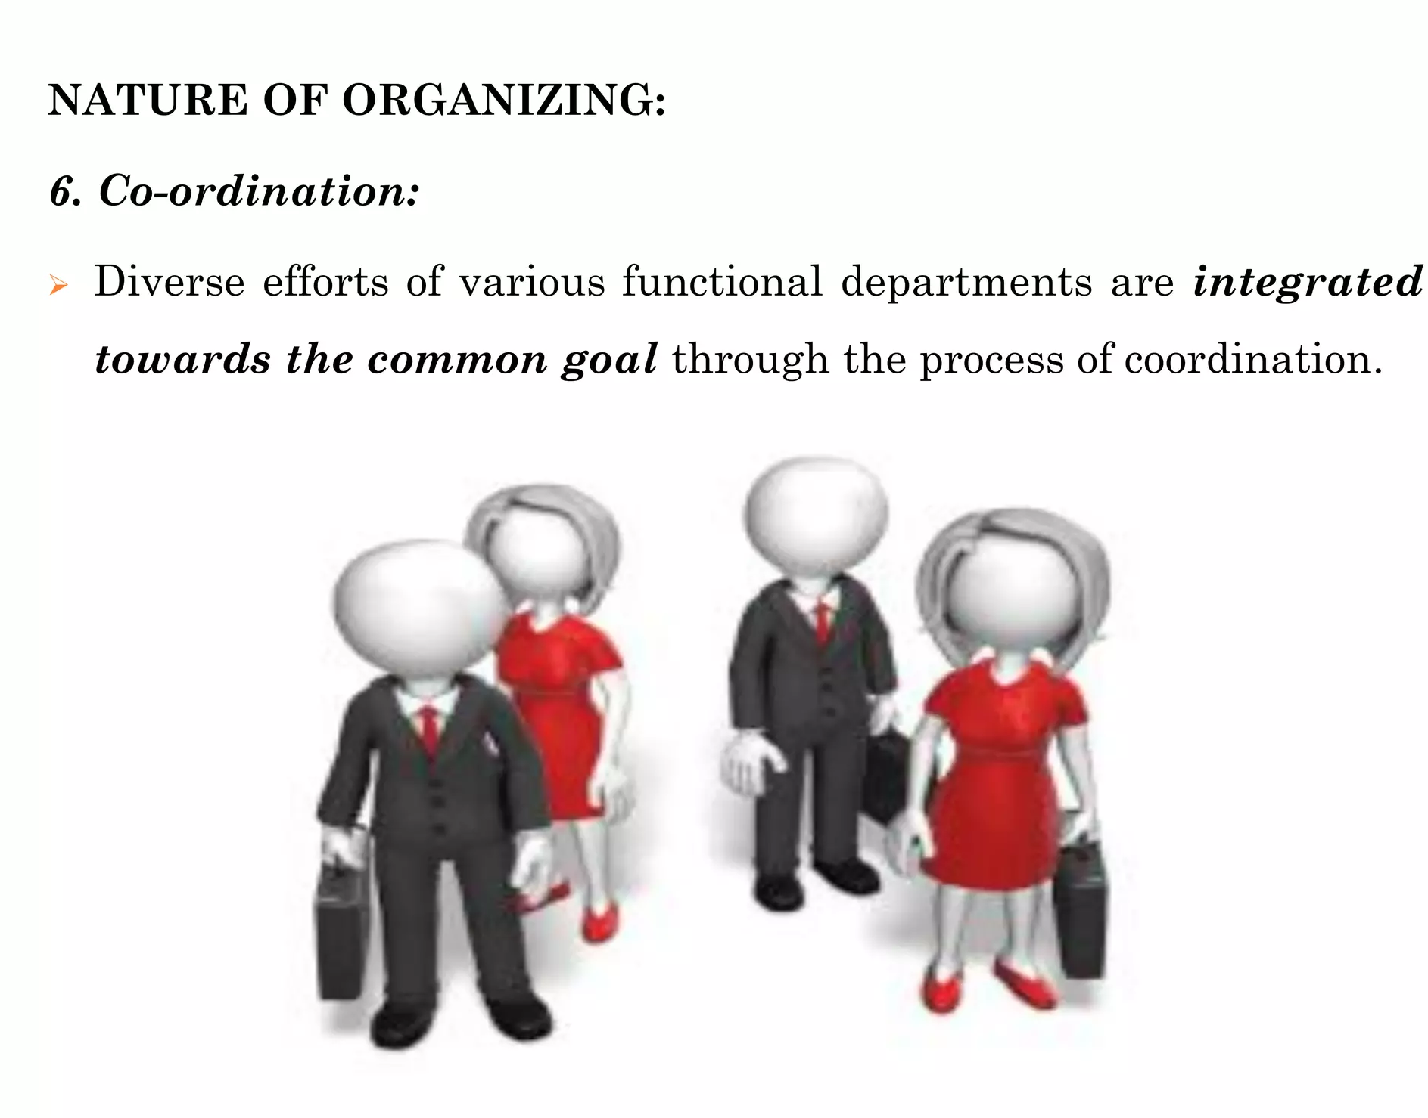

Slide 12
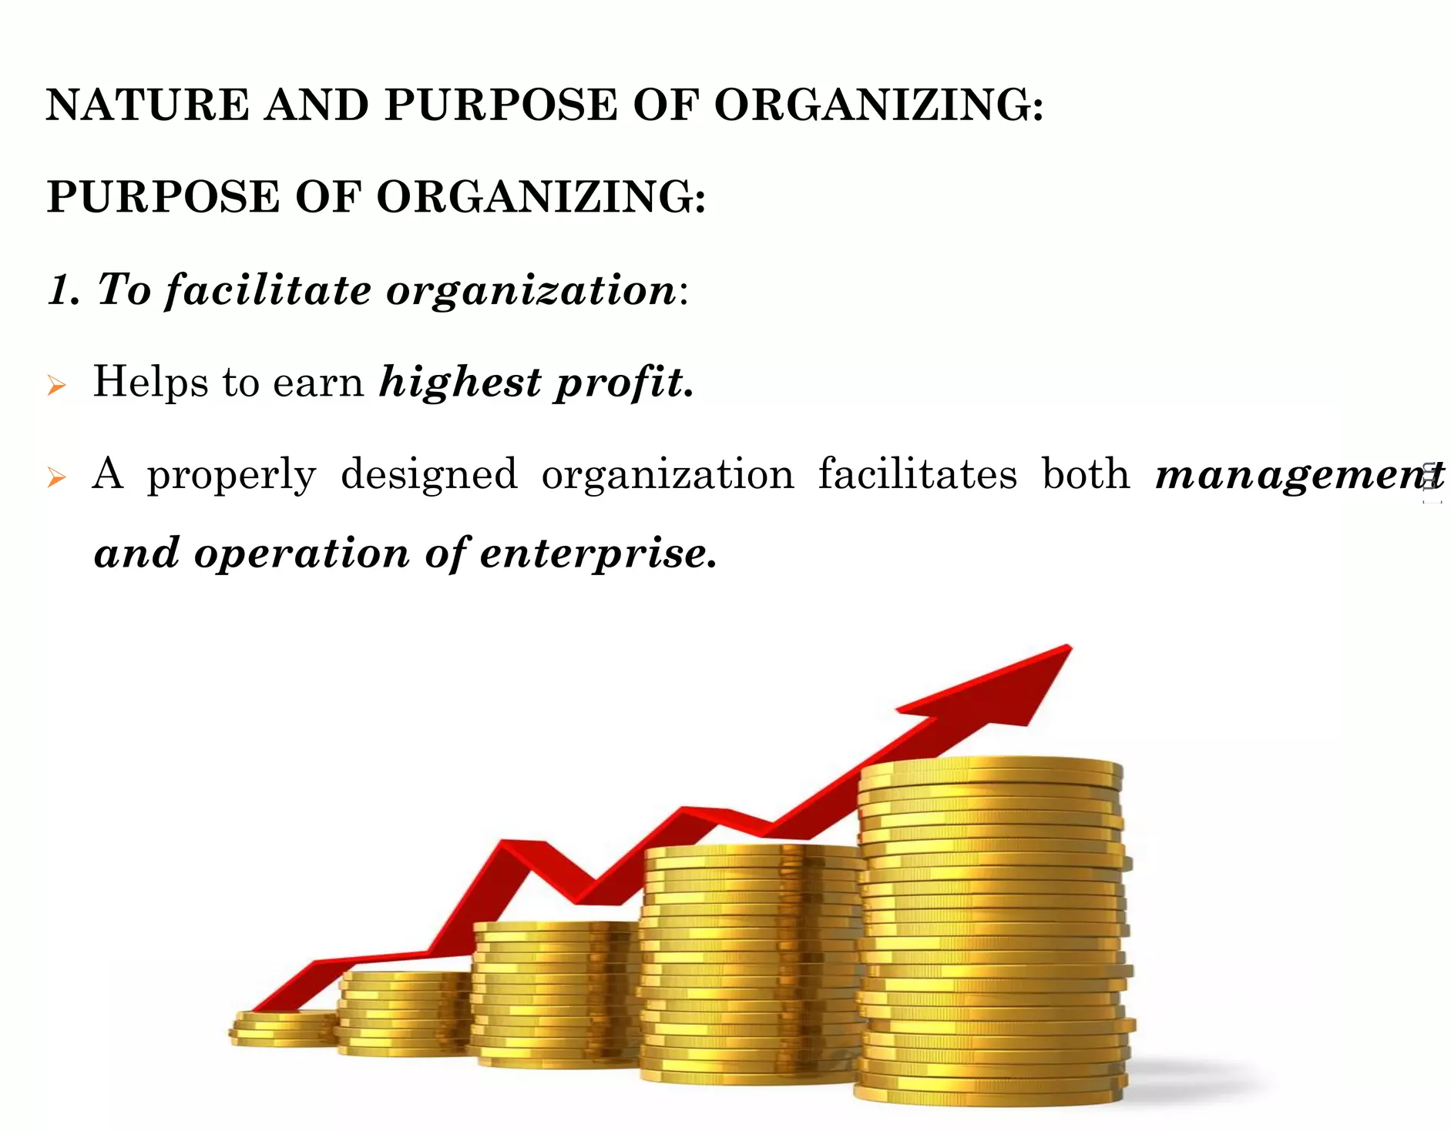

Slide 13
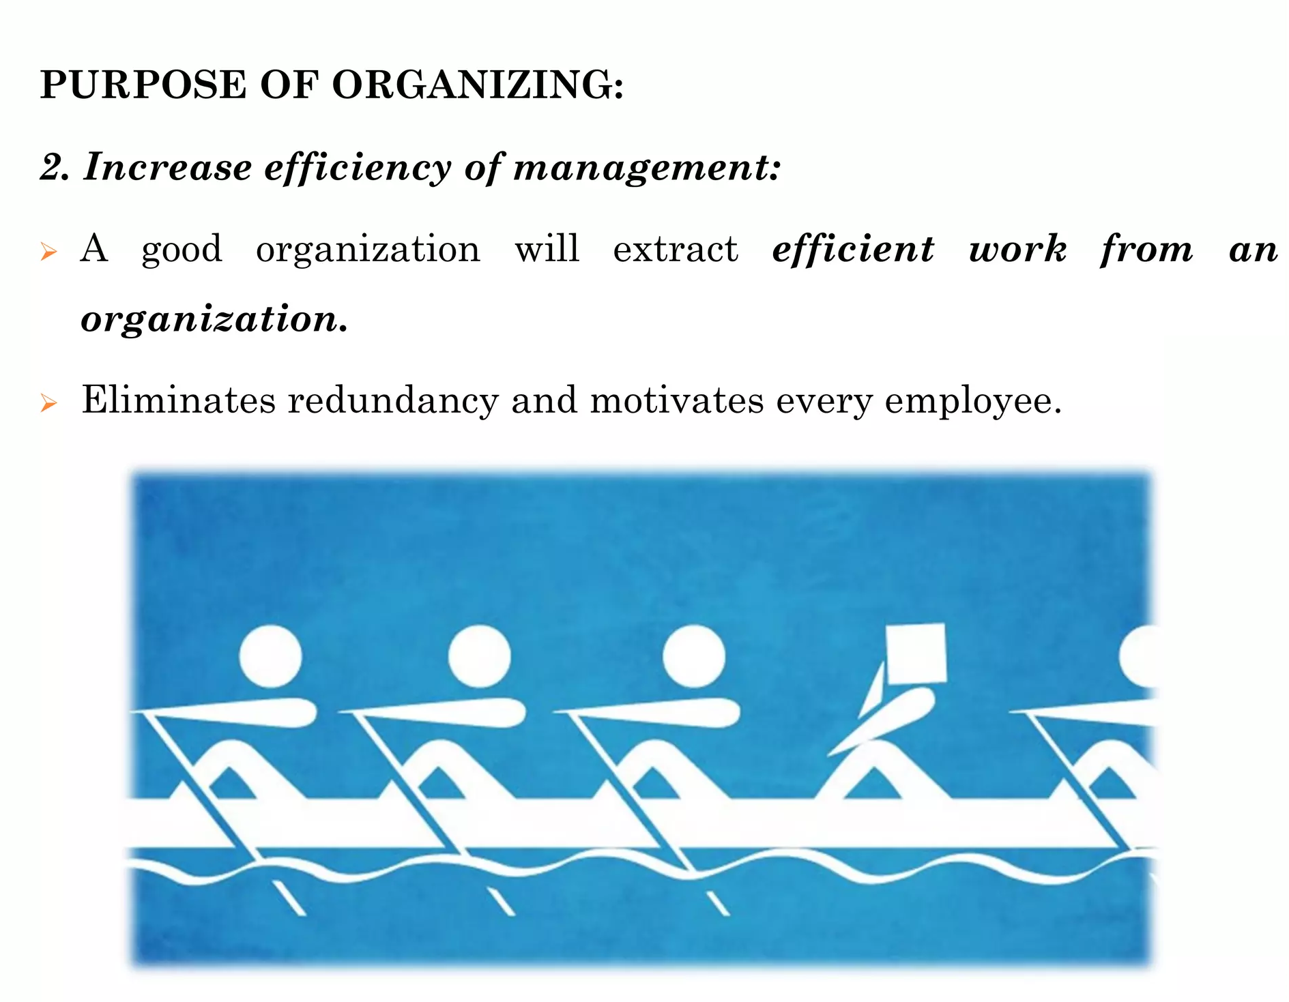

Slide 14
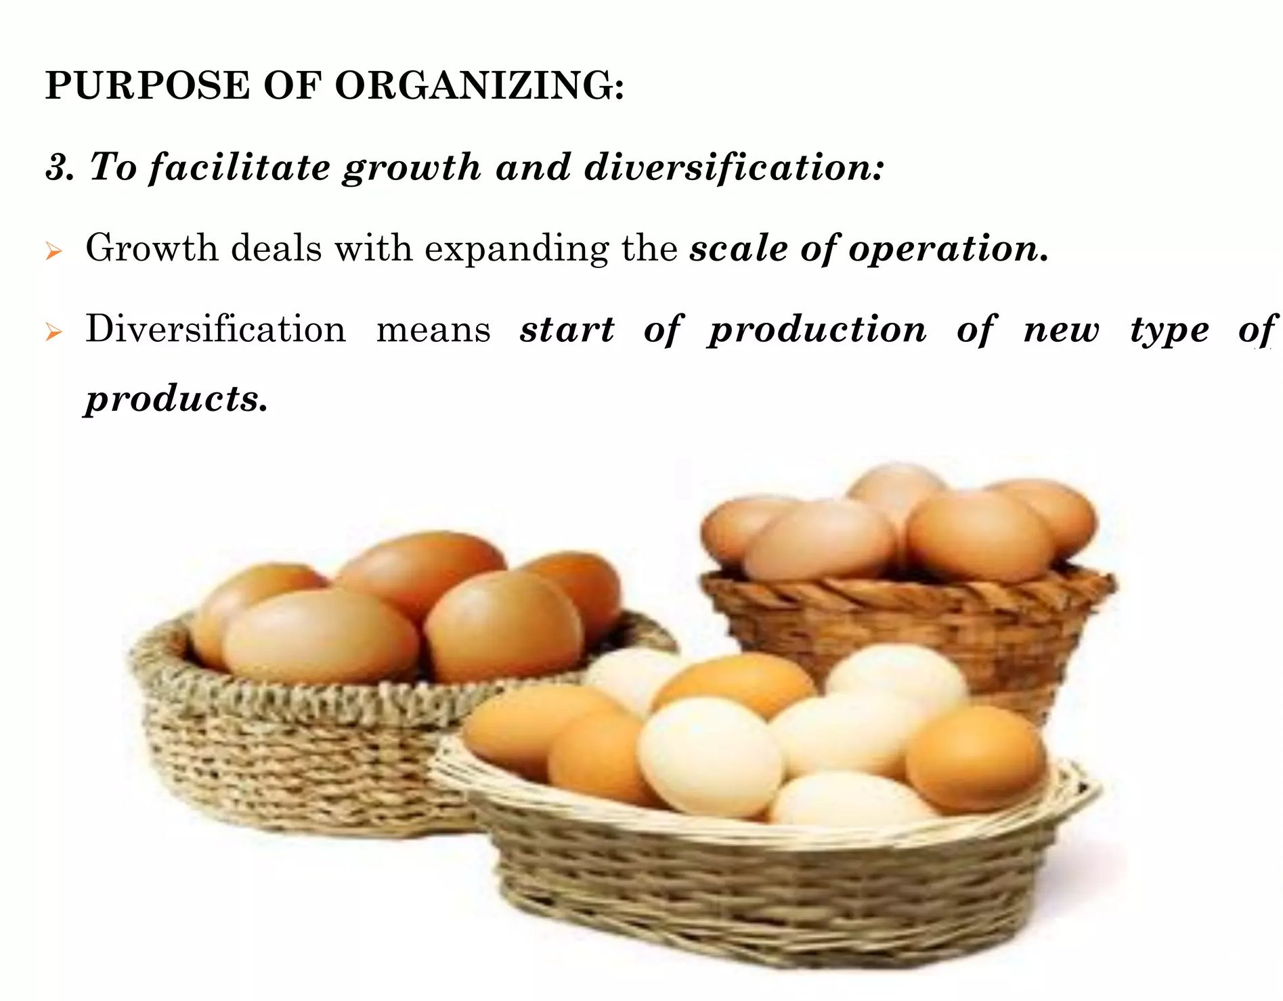

Slide 15
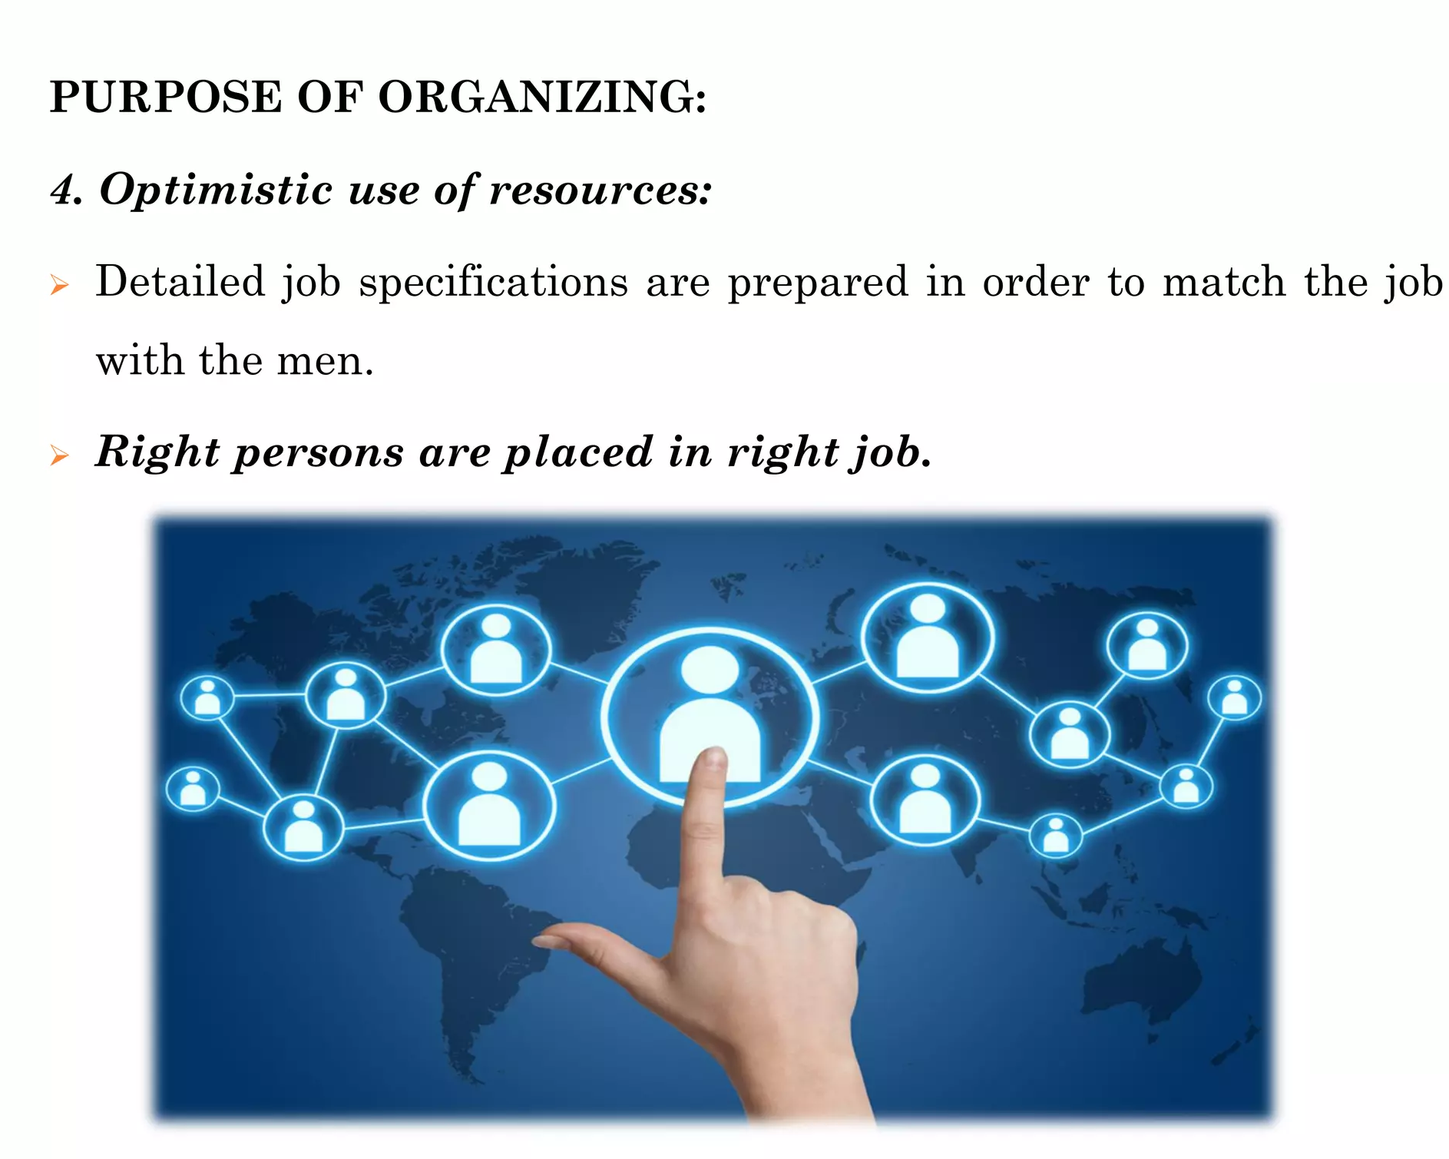

Slide 16
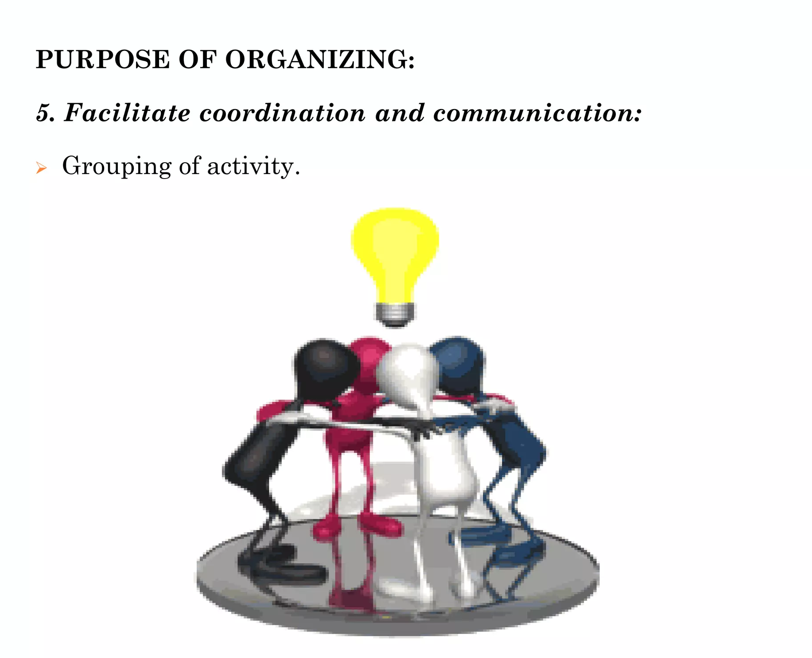

Slide 17
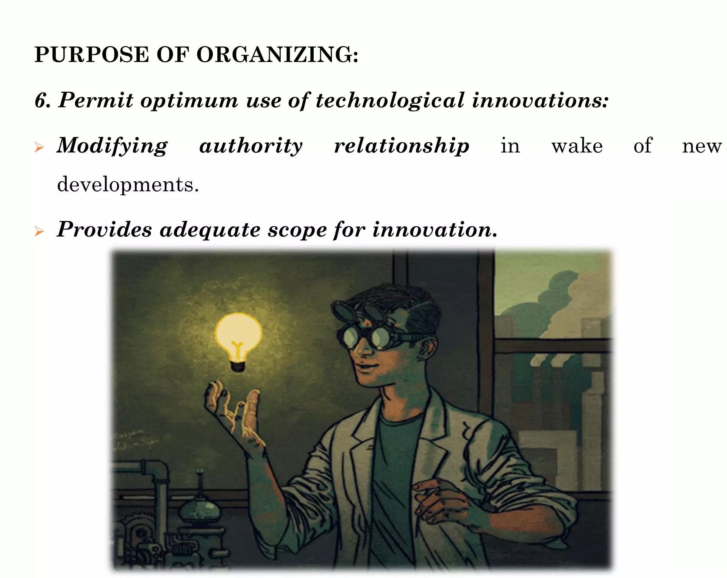

Slide 18
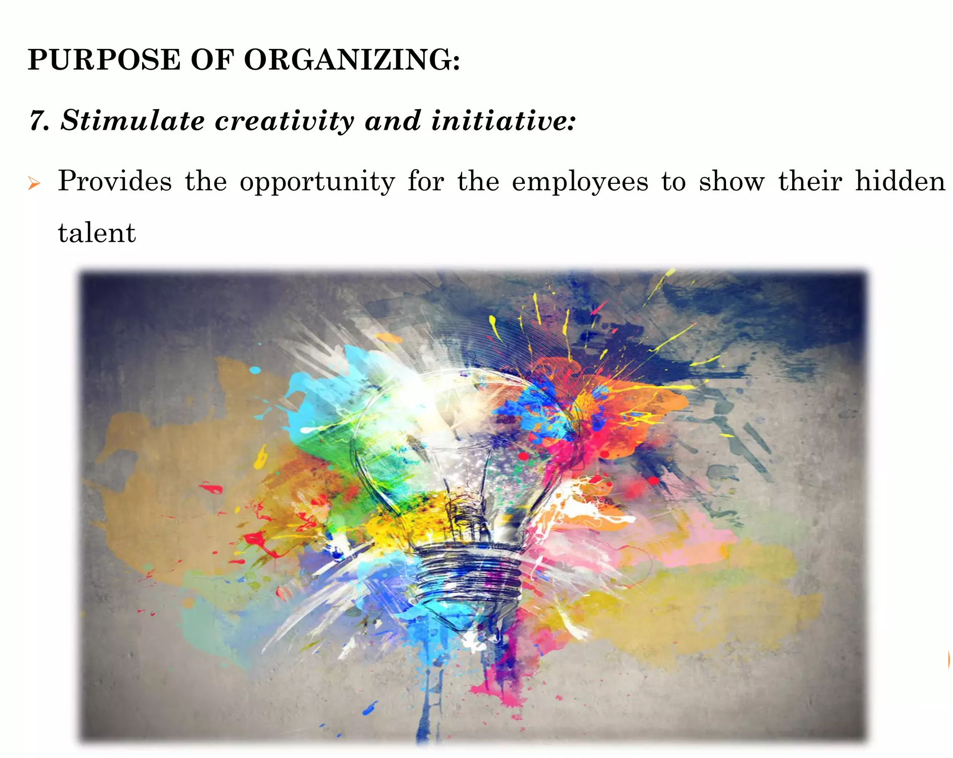

Slide 19
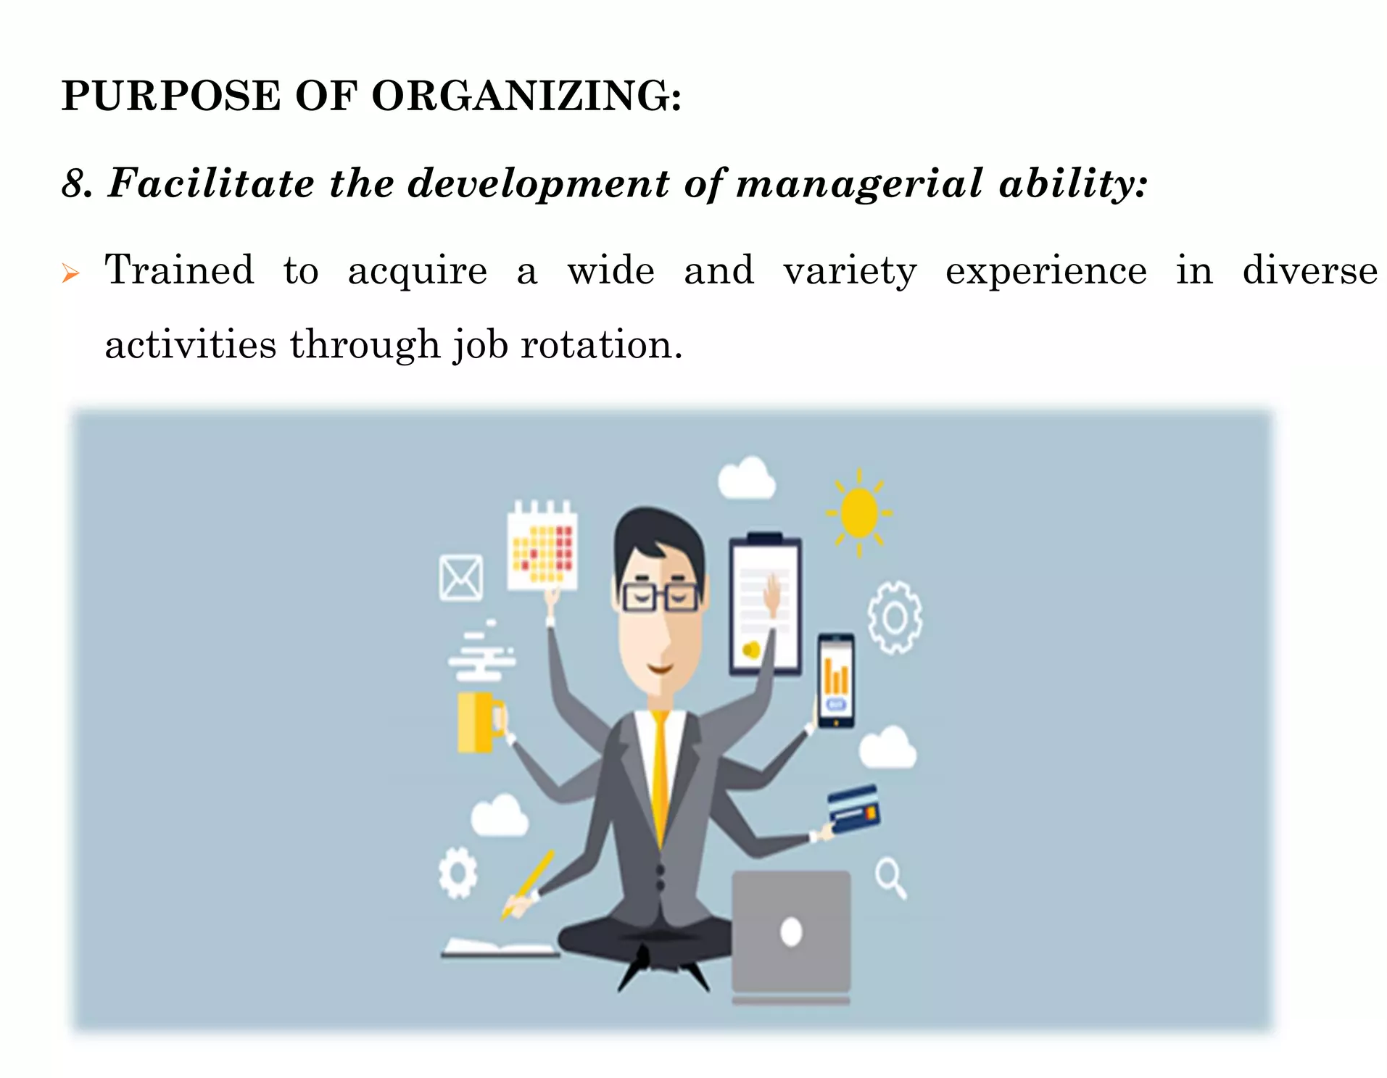

Slide 20
Organizational structure
An organizational structure is a system that outlines how certain activities are directed in order to achieve the goals of an organization.
These activities can include rules, roles, and responsibilities.
The organizational structure also determines how information flows between levels within the company.

Slide 21
Managerial problems of informal organisation
Social groupings may act collectively against organisational interests
Morale-damaging rumours
Employees may suffer if they excluded from the social grouping

Slide 22
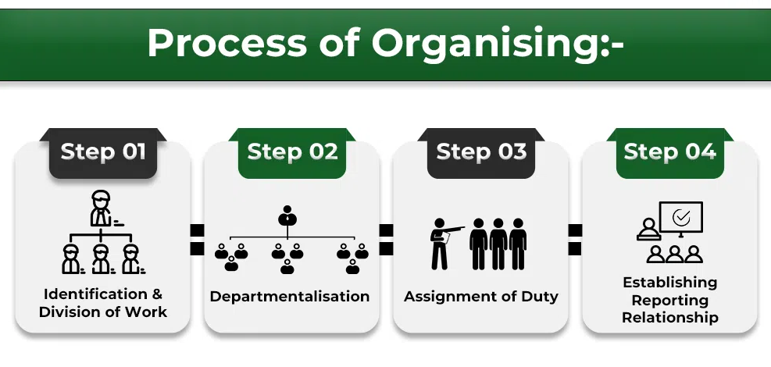

Slide 23
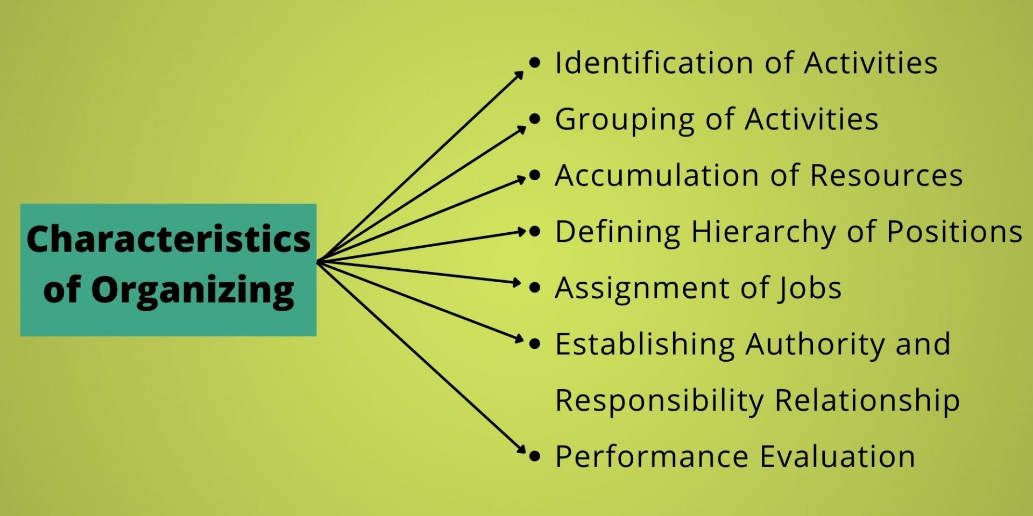

Slide 24
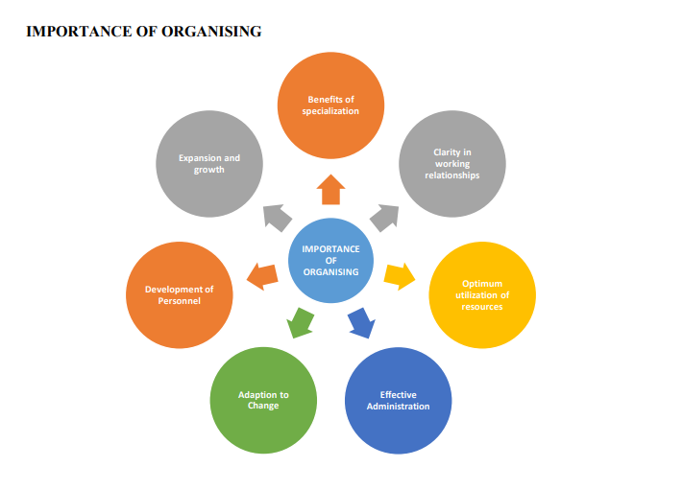

Slide 26
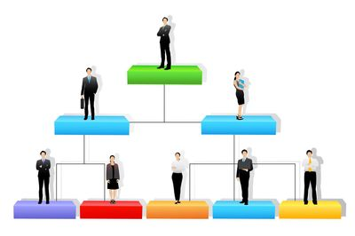
organization structure

Slide 27
organization structure
An organization structure refers to the hierarchical arrangement of roles, responsibilities, functions, and relationships within an organization.
It outlines how different tasks, activities, and people are grouped together and coordinated to achieve the organization's goals and objectives.
Organization structure provides a framework for communication, decision-making, and the allocation of resources.

Slide 28
Why do we need organisations Structure?
Organisations enable people to:
Share skills and knowledge
Specialise
Pool resources
Notes:
This results in synergy where organisations can achieve more than the
individuals could on their own

Slide 29
Key elements of an organization structure
Hierarchy of Authority: Defines management levels and who reports to whom, establishing chains of command.
Division of Labor: Allocates specific tasks and responsibilities to individuals or departments based on expertise.
Span of Control: Determines the number of direct reports a manager oversees for effective management.
Departments and Units: Groups functions or activities into departments for focused organization.
Reporting Relationships: Guides information flow and decision-making paths throughout the organization.
Coordination and Communication: Defines how different parts collaborate and interact for seamless operations.
Types of Structure: Different structures like functional, divisional, and matrix offer unique approaches based on goals and needs.

Slide 30
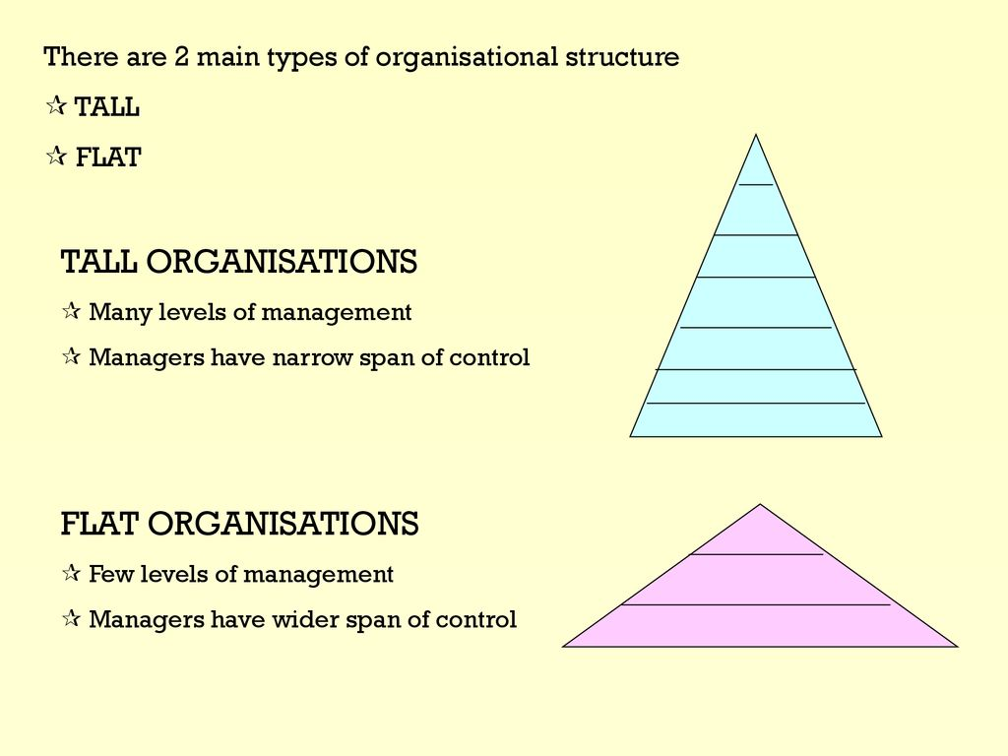

Slide 31
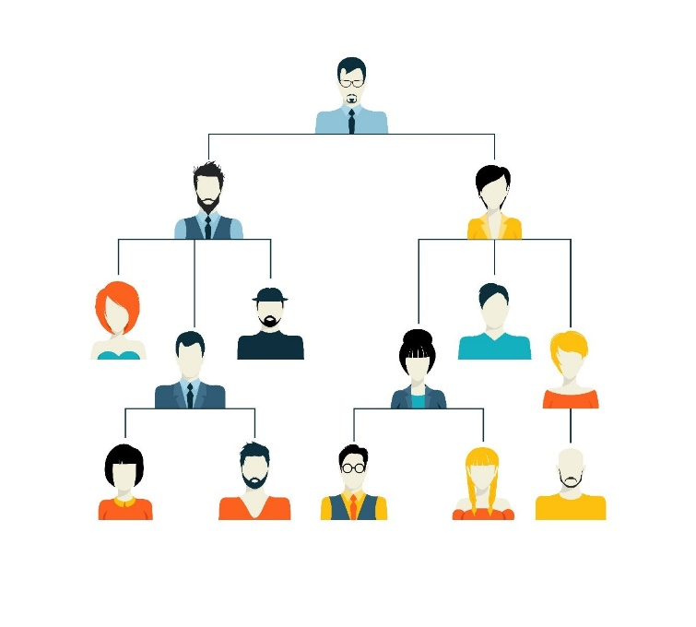
Formal Organization
The formal organisation is one that logically groups activities, allocation of authority and responsibility and the establishment of relationships to enable people to work most effectively together in accomplishing the objectives of the business.
A corporation like Apple Inc. is a formal organization. It has a well-defined organizational structure with different departments (such as R&D, Marketing, Sales, etc.), a clear hierarchy (CEO, VPs, Managers, Employees),
Notes:
It is important to note that these formal relationships emerge from the definition of the responsibilities attached to the holder of the post, for example, a relationship between the labourer and the supervisor because he is responsible for him.

Slide 32

Informal organisation
Informal Organisation which focuses attention on human relations and the way in which the actions of the people in the organisation deviate from the plan.
Within a company like Google, informal organizations might consist of groups of employees who regularly meet for lunch, form study groups, or participate in social activities together.
Notes:
However, there is the existence of the informal organisation which depends on the personalities of the people occupying the various positions in the organisational structure.

Slide 33
The benefits of an informal organisation can be:
Employee commitment
Knowledge sharing
Speed
Responsiveness
Co-operation
Notes:
E.G Managing a crises or disaster

Slide 34
Types of Organisational Structure
Functional Structure
Divisional Structure
Matrix Structure
Flat Structure
Hierarchical Structure
Network Structure
Team-Based Structure
Virtual Structure

Slide 35

Functional Structure:
Functional organisations group together employees that undertake similar tasks into departments.
Groups by specialized functions.
Efficient expertise within departments.
Limited cross-functional collaboration.

Slide 36
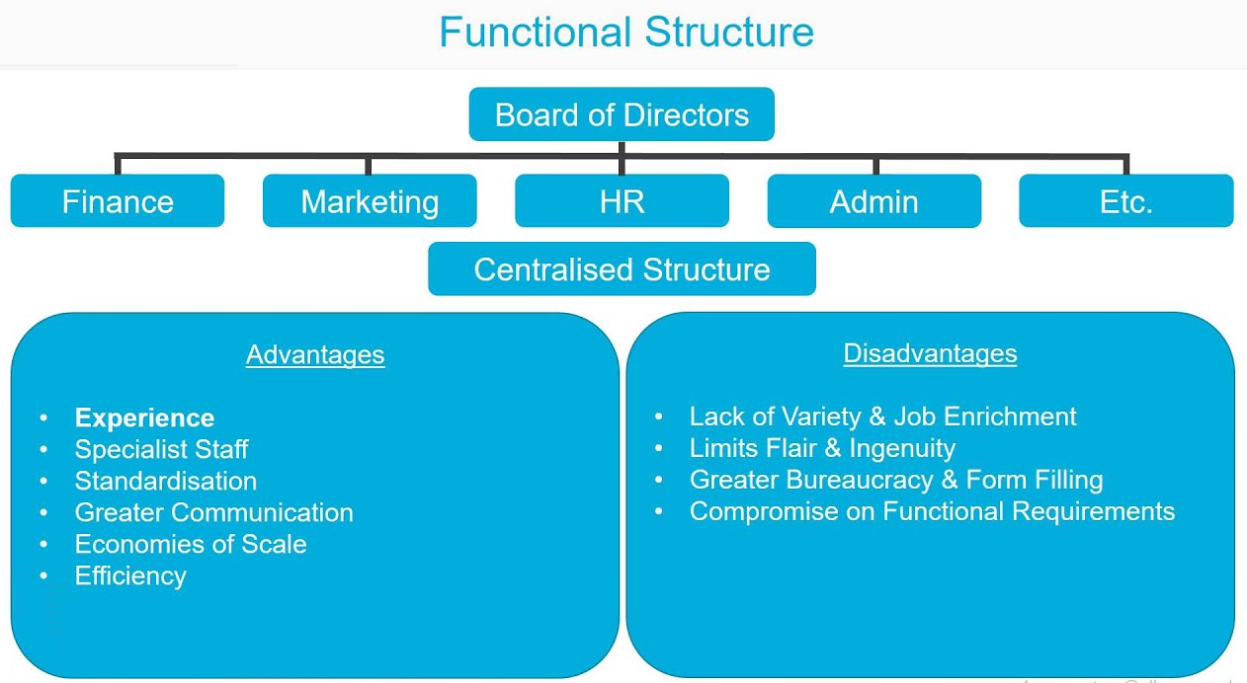

Slide 37
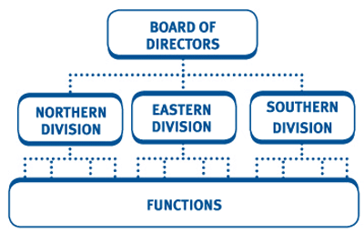
Divisional Structure:
Divides into autonomous divisions.
Tailored focus on products/regions.
Duplication of resources possible.

Slide 38
Matrix Structure:
Combines functional and divisional.
Dual reporting relationships.
Flexibility, but complexity and conflicts.

Slide 39
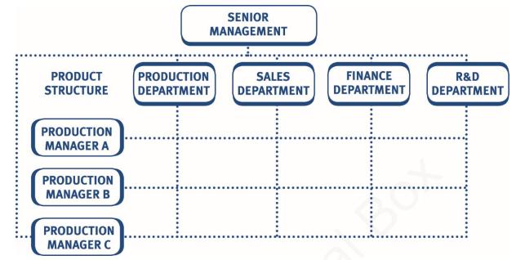
Matrix structure
Matrix structures are a combination of the functional and divisional structures.
Notes:
The matrix requires dual reporting to two different managers. For example,
looking at the diagram above, an employee manufacturing product A would
have to report to the manager of the production department and the manager in
charge of product A.

Slide 40
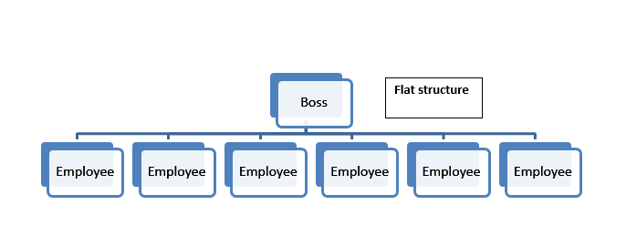
Flat Structure:
Minimal hierarchy levels.
Quick decisions, open communication.
Burdened top-level managers.

Slide 41
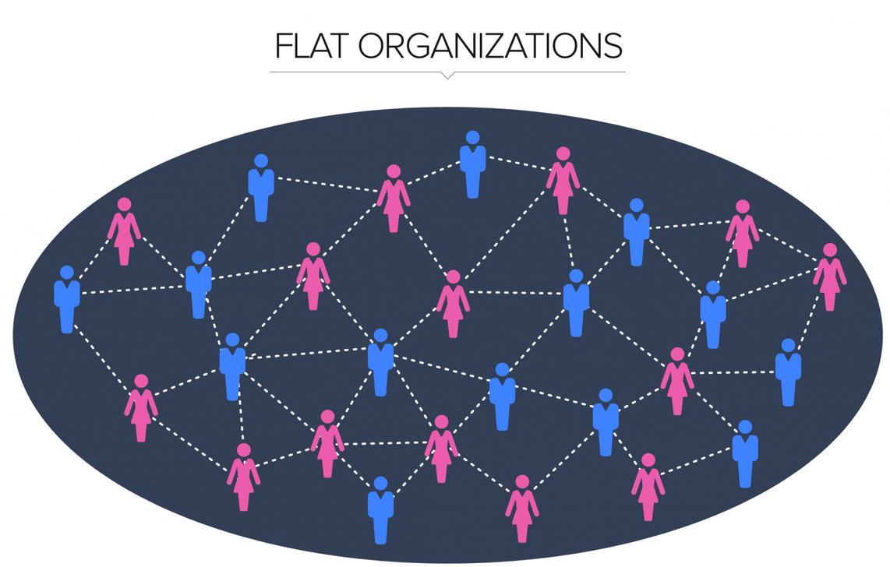
Flat organisations
A FLAT organisation is one which has a smaller number of organisational levels (scalar chain) and thus a wider span of control.

Slide 42
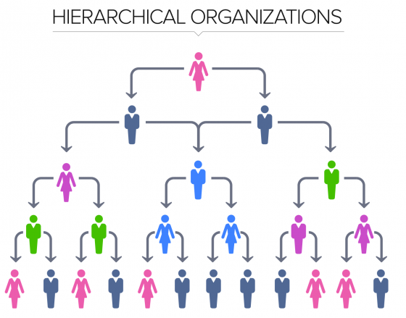
Hierarchical Structure:
Traditional pyramid.
Clear authority, slower decisions.
Well-suited for clear protocols.

Slide 43
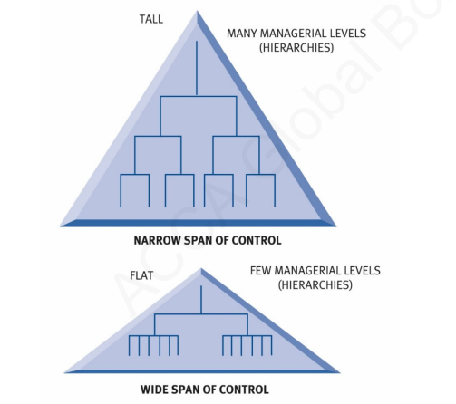
Tall organisations
If the span of control is very limited, the number of organisational levels (scalar chain) will increase, as the organisation grows in size, the organisational structure becomes TALL.
Notes:
The fact that the number of immediate subordinates is limited at each level tends to create close supervision and increased dependence of the subordinate on his principal.

Slide 44
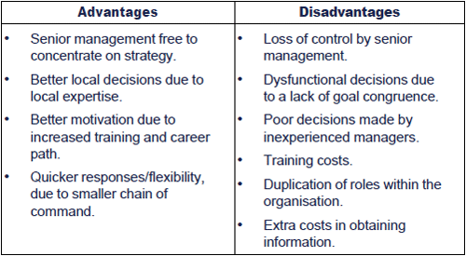
Benefits of tall organisational structure

Slide 45
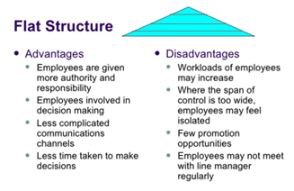
Benefits of Flat organisational structure

Slide 46
Network Structure:
A Network Structure in an organization refers to a flexible and decentralized organizational design that relies on a network of relationships—both internal and external—to accomplish goals and deliver value.
Relies on outsourcing, partnerships.
Flexibility, resource efficiency.
Strong external relationships needed.

Slide 47
Team-Based Structure
Organizational design where work is primarily organized around teams rather than traditional hierarchical departments or functions.
Self-managed project teams.
Collaboration, empowerment.
Alignment and resource challenges.

Slide 48
Virtual Structure:
This occurs where an organisation outsources many of its functions to other organisations and simply exists as a network of contracts, with very few, if any, functions being kept in-house.
Technology-connecting dispersed teams.
Flexibility

Slide 49
Hollow organisations
Hollow organisations split their functions into core (i.e. strategically important) and non-core activities. Anything which is classified as non-core is outsourced to other organisations

Slide 50
Organization Size and organization Structure
An organization's size and industry significantly influence its choice of organizational structure.
The optimal structure for one organization may not be suitable for another, and it depends on various factors
Example: Start-ups , Reliance, GE etc

Slide 51
Based on Organization Size
Small Organizations (Startups, Small Businesses):
Flat Structure: Smaller organizations often benefit from a flat organizational structure.
It encourages open communication, quick decision-making, and flexibility.
In such structures, there are fewer layers of management, and employees often have multiple roles.

Slide 52
Continue….
Medium-Sized Organizations:
Functional or Divisional Structure: As organizations grow, they may adopt a more functional or divisional structure. This allows them to specialize in different areas or products while maintaining a level of efficiency.

Slide 53
Continue..
Large Organizations (Corporations):
Matrix or Divisional Structure: Large organizations frequently employ matrix structures to balance efficiency and specialization.
They might have multiple divisions or departments, each with its own hierarchy, and matrix teams that work across functions or projects.

Slide 54
Based on Industry…
Industry:
Manufacturing: Hierarchical for control.
Technology: Flat or matrix for innovation.
Service: Matrix or network for expertise.
Non-profit/Government: Hierarchical and functional.

Slide 55
Teams
A team is a specific type of group that is formed for a particular purpose, often involving a common goal or task.
Teams typically have a structured organization, designated roles, and a strong focus on collaboration to achieve a shared objective

Slide 56
Characteristics of Team:
Common Goal: Teams are brought together to accomplish a specific goal.
Roles and Responsibilities: Team members have defined roles and responsibilities that contribute to the achievement of the team's objective.
Interdependence: Team members rely on each other's contributions and expertise.
Shared Accountability: Team members are collectively accountable for the team's performance and outcomes.
Communication: Communication within teams is frequent and focused on task-related matters.

Slide 57
Groups:
Collections of people who come together for various purposes. Groups can be formal or informal and may not always have a specific task or goal.

Slide 58
Characteristics of Groups:
Diverse Purposes: Groups can form for a wide range of reasons, including social interaction, sharing common interests, or addressing specific tasks.
Varied Structure: Groups may have varying levels of structure.
Interaction: Interaction within groups may not always be task-focused; it can include socializing, sharing information, or pursuing common interests.
Accountability: Accountability in groups can be less clear than in teams, as not all groups have shared objectives or outcomes.

Slide 59
Types of Groups
Formal Groups
Informal Groups

Slide 60
Formal groups
Formal groups in organizations are intentionally created and structured groups that serve specific functions and roles within the company.
These groups are established to achieve organizational objectives and typically have a designated leader.

Slide 61
Characteristics formal Groups :
Purpose-Driven: Formal groups exist to accomplish specific tasks, projects, or functions within the organization. They have a clear purpose aligned with the company's goals.
Hierarchy: They often have a defined hierarchy.
Structured: Formal groups have set rules, procedures, and guidelines for their operations. These structures help ensure efficiency and accountability.
Official Recognition: They are officially recognized by the organization and may be documented in the company's organizational chart or policies.
Examples: Departments like finance, marketing, or human resources are formal groups.

Slide 62
Benefits:
Clear accountability and responsibility.
Efficient coordination and execution of tasks.
Alignment with organizational goals.
Defined channels for communication and decision-making.

Slide 63
Informal Groups
Informal groups are natural, social structures that develop among employees based on shared interests, common backgrounds, or personal relationships.
These groups are not officially designated or structured by the organization.

Slide 64
Characteristics of Informal groups
Voluntary: Employees choose to be part of informal groups based on personal preferences or social connections.
Social Bonds: Informal groups form around social interactions
No Designated Leader: They often lack an officially designated leader
Fluid and Dynamic: Informal groups can change and evolve over time as employees come and go
Examples: Lunch groups, after-work sports teams, or interest-based clubs within the workplace are common examples of informal groups.

Slide 66
PERFORMANCE APPRAISALS

Slide 67
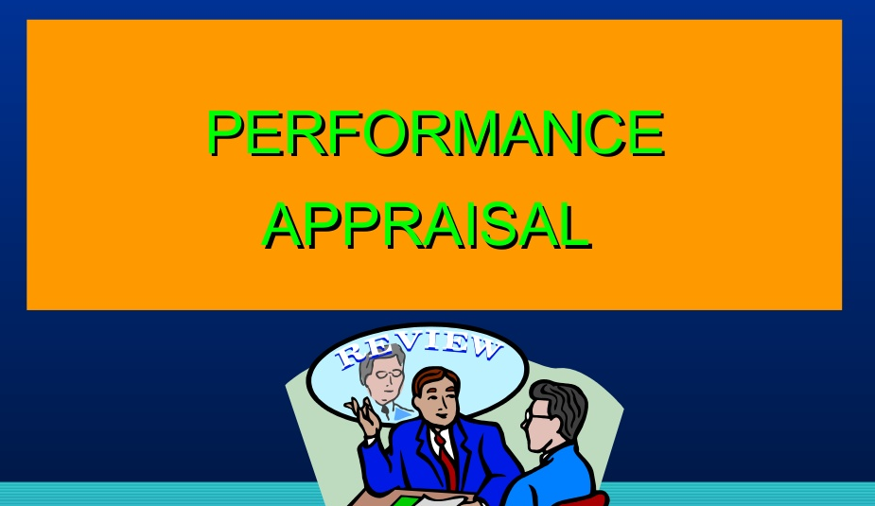

Slide 68
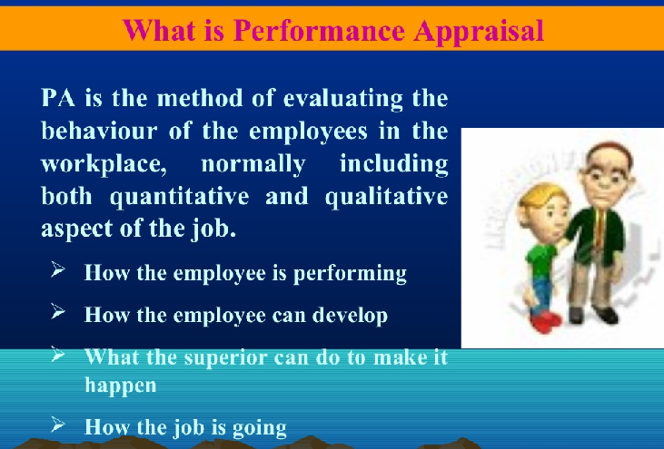

Slide 69
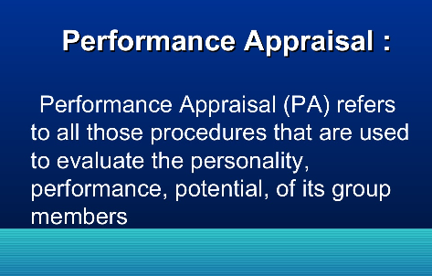

Slide 70
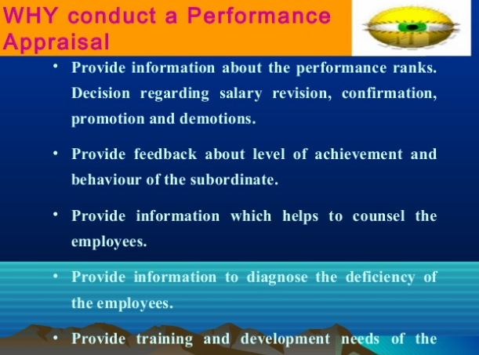

Slide 71
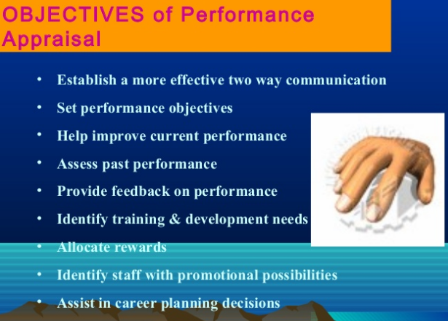

Slide 72
Who Performs the Appraisal?
Immediate Supervisor
Higher Management
Self-Appraisals
Peers (Co-Workers)
Evaluation Teams
Customers
“360° Appraisals”

Slide 73
Supervisor Appraisal
Performance appraisal done by an employee’s manager and often reviewed by a manager one level higher.

Slide 74
Self-Appraisal
Performance appraisal done by the employee being evaluated, generally on an appraisal form completed by the employee prior to the performance review.

Slide 75
Subordinate Appraisal
Performance appraisal of a superior by an employee, which is more appropriate for developmental than for administrative purposes.

Slide 76
Peer Appraisal
Performance appraisal done by one’s fellow employees, generally on forms that are complied into a single profile for use in the performance interview conducted by the employee’s manager.

Slide 77
Team Appraisal
Performance appraisal, based on TQM concepts, that recognizes team accomplishment rather than individual performance.

Slide 78
The 360º Appraisal Interview
Supervisor
Other Superiors
Other Superiors
Individual Staff
Self-Assessment
Peers
Customers
Teams
Teams
Sub-Ordinates

Slide 79
Appraisal Methods
Rating Scales
Essay
Management by Objectives
Check Lists by Key Words
Forced Choice Statements
Ranking of Employees

Slide 80
Rating Scale Methods (most popular)
(Check each trait being evaluated)
Global Scale (Total Performance)
Mixed Standard Scale (Choose from Different Statements)
Behaviorally Anchored Rating Scale (Descriptions along the scale to define)

Slide 81
Behaviorally Anchored Rating Scale (BARS)
A behavioral approach to performance appraisal that consists of a series of vertical scales, one for each important dimension of job performance.

Slide 84
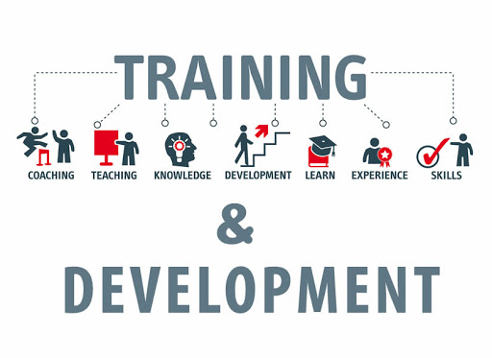
HRD Training and Development

Slide 85
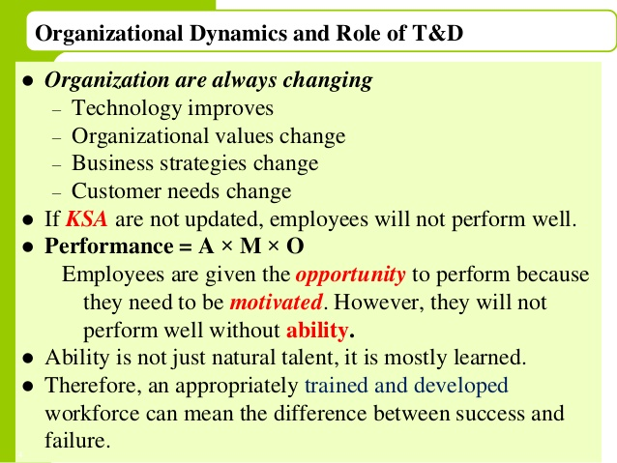

Slide 86
Training
It is an attempt to improve current or future employee performance by increasing an employee’s ability to perform through learning, usually by changing the employee’s attitudes or increasing his or her skills and knowledge.
It aimed to improve productivity
More focus on improving skills for current job
It’s a learning progress

Slide 87
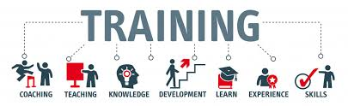
Training
Training is basically a systematic procedure for transferring technical know-how to the employees so as to increase their knowledge and skills for doing particular jobs.
Training usually involves teaching operational or technical employees how to do their jobs more effectively and/or efficiently.
Training is a process of teaching a new employees the basic skills to perform their jobs - Garry Dessler

Slide 88
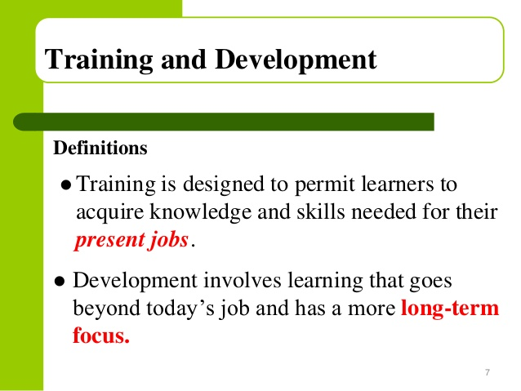

Slide 89
Development
Efforts made to improve employee’s ability to handle a variety of assignment.
Development is a process of preparing employees for future position and improve their personal skills to handle the critical situations in an organization.
Development is generally aimed at helping managers better understand and solve problems, make decisions, and capitalize on opportunities.
Development is often considered a HR function.

Slide 90
Education:
It is the understanding and interpretation of knowledge.
Education must impart qualities of mind and character, understanding of basic principles, synthesis and objectivity. Usually, education involves a range of skills and expertise, which can be provided only by educational institutions.

Slide 91
Benefits of Training
How training benefits the organisation
Leads to improved profitability and or more positive attitudes toward profits orientation.
Improves the job knowledge and skills at all levels of the organisation.
Improves the morale of the workforce.
Helps people identify with organisational goals.
Helps create a better corporate image.
Fosters authenticity, openness and trust.
Improves the relationship between boss and subordinate.
Aids in organisational development.

Slide 92
Aids in understanding and carrying out organisational policies.
Provides information for future needs in all areas of the organisation.
Organisation gets more effective in decision-making and problem solving.
Aids in development for promotion from within.
Aids in developing leadership skills, motivation, loyalty, better attitudes and other aspects that successful workers and managers usually display.
Aids in increasing productivity and/or quality of work
Helps keep costs down in many areas, e.g. production, personnel, administration etc.
Develops a sense of responsibility to the organisation for being competent and knowledgeable.
Improves labour-management relations.
Reduces outside consulting costs by utilising competent internal consulting.
Creates an appropriate climate for growth and communication.
Helps employees adjust to change.
Aids in handling conflict, thereby helping to prevent stress and tension.

Slide 93
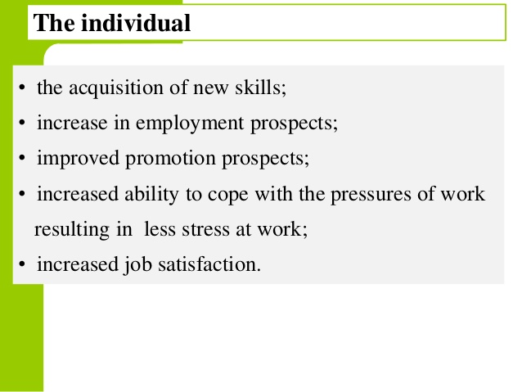

Slide 94
Importance of Training
Trained workers can work more efficiently.
There will be fewer accidents.
As training improves the knowledge of employees regarding the use of machines and equipment.
Wastage is eliminated to a large extent as they use tools, machines in a proper way.
Training helps an employee to move from one organization to another easily.
He can be more mobile and pursue career goals easily.

Slide 95
Importance of Training
Training makes employees more loyal to an organization.
They will be less inclined to leave the unit where there are growth opportunities.
Training enables employees to secure promotions easily.
They can realize their career goals comfortably.
Economical supervision-as there is less requirement for supervision for trained employees.

